Slide 1


presented by:
Solidity 101 Workshop

Slide 2
Agenda
Ethereum
Smart Contract
Solidity Basics
Additional Smart Contract Theory
Escrow Contracts

Slide 3
What is Ethereum
Open platform software based on blockchain technology
Creation and deployment of decentralized applications
Broader range of use cases as compared to Bitcoin (which is solely a cryptocurrency)
Runs on Ether: a crypto token that fuels the network
Main programming language: Solidity

Slide 4
Ethereum Virtual Machine
A runtime environment for smart contracts
Transaction based machine
Takes advantage of a consensus protocol to make decisions (currently Proof of Work)

Slide 5
What is a Smart Contract?
A self-executing program that automates the verification of conditions
Allows credible transactions without 3rd parties
Trackable, immutable (stored on blockchain)

Slide 6
Smart Contract In Practice
A container for information (state variables) and functionality (functions)
Data is stored on the contract, and execution happens when conditions are met
Contracts cost GAS to run, which is paid for with ether

Slide 7

Polymorphism
Smart Contracts don’t have to be independent
Import statements and class extension for inheritance
Syntax:

Slide 8
Smart Contract: Use Cases
EtherDelta
Implements an exchange to exchange of Ether
Checks for sufficient funds (tokens) for both sides of the deal and runs the exchange.
Replaces middleman such as a bank!
Marriage Contract
One party proposes to second party.
If both parties agree, funds are withdrawn from both parties’ accounts and put into joint account.
Status changed to “married”
If one party requires “divorce”, funds are split into two halves!
Etheroll
Gambling on the EVM!
Place bets and profit is transferred to your account when won
Comparable to casino!

Slide 9
Solidity Basics

Slide 10

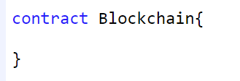
To start off
Compiler Version
“^” limits compiler version up to 0.5.0
Declare Contract
The start of every contract

Slide 11
Variable Types
boolean: true, false
int/uint: signed and unsigned integers
string: dynamically-sized string, e.g.: “Welcome to Solidity 101”
enum: user-defined type
address: an Ethereum address. 20 bytes
(more on this later)

Slide 12
Operators
Comparison (boolean)
>= , > , <= , < , != , ==, &&
Arithmetic (uint)
+, -, *, **, /, %

Slide 13
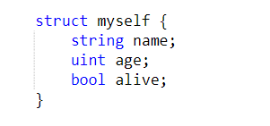

Reference Types
Arrays
Used when you want a collection of a specific type.
Can be of 2 types:
Fixed: has a fixed length of elements.
Dynamic: no fixed size; can keep growing
Structs
A custom type with multiple fields/variables

Slide 14
Addresses
The Ethereum network is made of addresses that are owned by users or smart contracts which can store Ether, similarly to personal bank accounts
An address is 160 bits (base 2) long, or 40 hex digits (base 16) They look like this : 0x0cE446255506E92DF41614C46F1d6df9Cc969183
Mapping
Storage of key-value pairs (think of Hash Tables)

Slide 15
Example use of Addresses and Mapping
mapping (address => uint) favoriteNumber;
// Set value of favorite number at sender address function setMyNumber(uint _myNumber) public { favoriteNumber[msg.sender] = _myNumber; }
// Return value of sender address function whatIsMyNumber() public view returns (uint) { return favoriteNumber[msg.sender]; }

Slide 16

Functions
A specific piece of code that will execute tasks inside the contract
Similar to other object-oriented programming languages
General syntax of a function:
Syntax of a function for calculating average value:
function NAME() VISIBILITY MODIFIER returns (RETURN TYPE) { }
function average (uint a, uint b) public returns (uint) {
returns (a+b)/2
{

Slide 17
Functions cont.
Function Visibility
Remember functions produce actions BUT you don’t always want everyone to be able to access them
external: accessible from the outside only, part of contract interface
public: accessible from everywhere, part of contract interface (functions are public by default)
internal: only accessible internally, and in derived contracts
private: only accessible inside the contract it is defined in (but not derived contracts)

Slide 18
Functions cont.
Function Modifiers
view: does not modify data, only views it
function myFunction() public view returns(uint) { }
pure: does not access contract data, only parameters
function multiply(uint a, uint b) private pure returns(uint) { return a * b; }

Slide 19
Error Handling/ Conditions
Require
The require function is meant to be used for input validation.
Requires certain condition to continue with the code; otherwise reverts and refunds gas if the condition is false.
function setUserAge(uint age) public {
require(age > 0);
Myage = age;
}
Can be a great way to make sure only a certain user can call a function (if you would like to limit the function’s use)

Slide 20
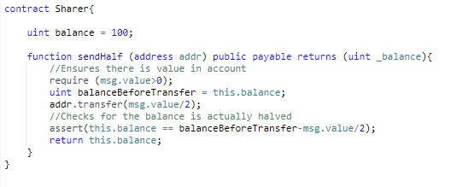
Error Handling/Conditions cont.
Assert
Also reverts when the condition is false, but uses all gas
Often used for internal errors or to check for invalid state to detect bugs

Slide 21
Your Turn!
Make a Hello World contract

Slide 22
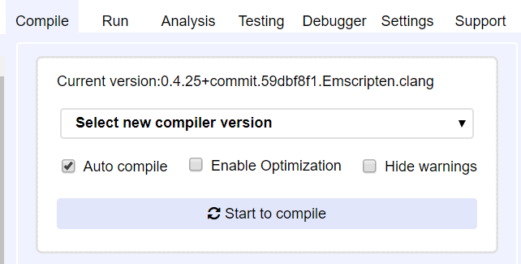
Setting up Remix
Open remix.ethereum.org
Select Auto compile

Slide 23
Remember
Compiler version
Declare Contract
State variables
Functions
Return output!

Slide 24
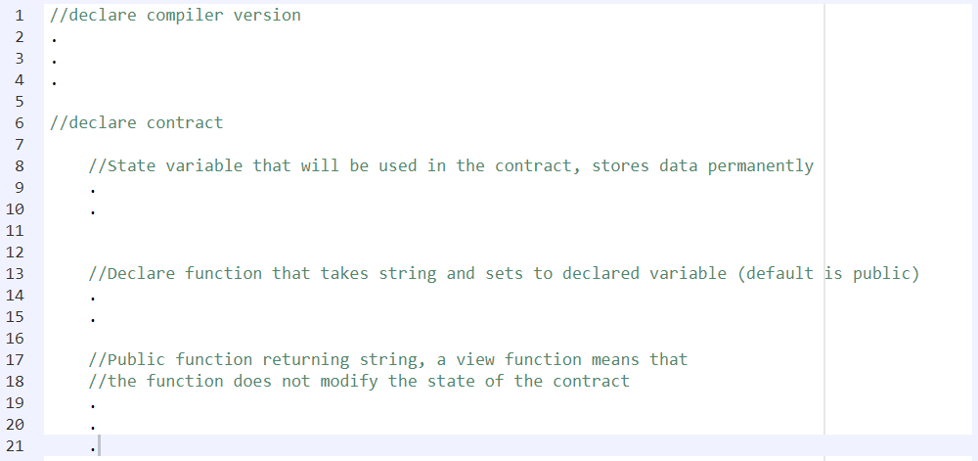
Hello World Pseudocode
Try it!

Slide 25
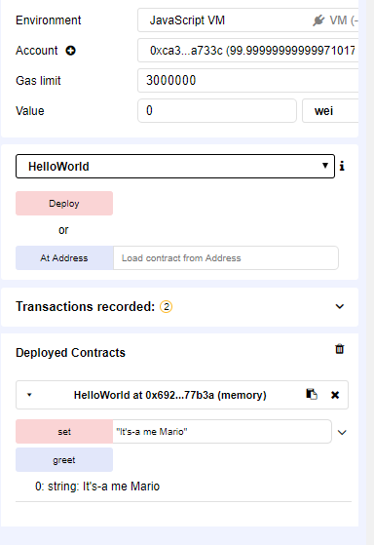
Deploying the Contract
Click “Deploy”
Click the dropdown. Type your greeting with quotation marks and click “set”, then click “greet”

Slide 26
Questions so far?

Slide 27
Block and Transaction Properties
msg.value : value (wei) of message sent during function call
i.e.: require(msg.value == 25);
msg.sender : address of contract initializer or function caller

Slide 28
More Solidity Theory
Payable functions
Allows contracts to receive and hold funds
function deposit() public payable {
deposits [msg.sender] += msg.value
}
Functions can take in a certain amount of Ether in wei
(1 wei = 1e-18 ether)
Note: Without the “payable” function keyword, any transactions involving payments will be reversed!

Slide 29
Gas on Ethereum Network
Gas concept
Every operation that can be performed by a transaction or contract costs a certain amount of gas which is paid in ether
Cost is proportional to computation cost
The market decides the most viable ether/gas cost proportion
Distinction: gas cost is the amount of work required to perform an action in the EVM, gas price is the amount of ether you pay

Slide 30
Gas on Ethereum Network
Gas economics
If your gas price is too low, no one will process your transaction
If your gas price is high, your transaction will be run but you will pay more than you might have needed to.
If your gas price is fine but the gas cost of your transaction runs "over budget" the transaction fails but still goes into the blockchain, and you don't get the money back for the work that the miners did.
This makes sure that nothing runs forever, and that people will be careful about the code that they run. It keeps both miners and users safe from bad code!

Slide 31
Storage vs Memory
“Storage” is where all the contract’s state variable reside.
Every contract has its own storage and will remain there between function calls.
It is quite expensive to use since it will be using storage space in the EVM
Is the default setting.
“Memory” is used to hold temporary values.
It is erased between external functions calls.
Much cheaper to use since it will not use storage space in the EVM.
Ideal to use for intermediate variables inside functions.

Slide 32
Cryptographic Hash Functions
Used to map data of arbitrary size to data of a fixed size.
Returns hash values or hash codes.
Meant to encrypt data securely
Ethereum uses “keccak256”
They are irreversible
Unique; 2 different data cannot have same hash.
“Avalanche effect”; any small change results in big change of hash.
Deterministic; same input always has same hash.

Slide 33
Escrow Contract
A contract that serves as the third person (escrow agent) in a contract
The code imitates the legal document that outlines the terms and conditions agreed between parties
Ensures both parties fulfill its obligations
The buyer deposits assets while the seller delivers the goods who will then receive the assets once the buyer receive the goods

Slide 34
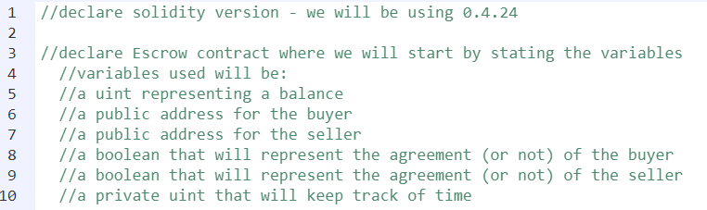
Writing an Escrow Contract!
Step one:

Slide 35
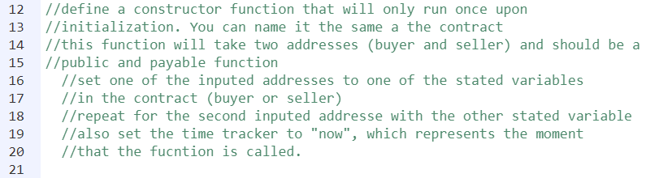
Writing an Escrow Contract!
Step two:

Slide 36
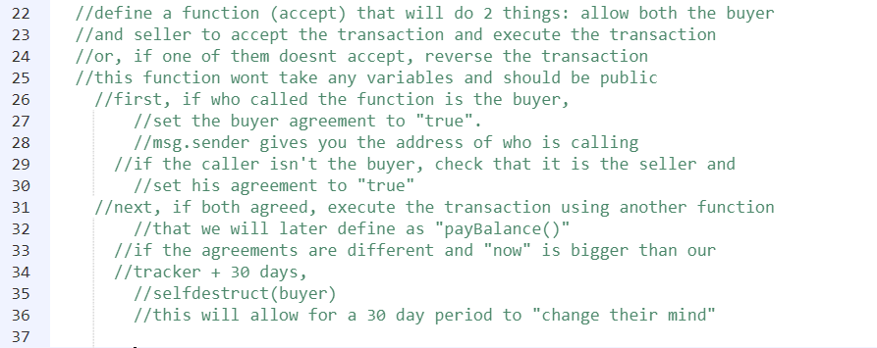
Writing an Escrow Contract!
Step three:

Slide 37
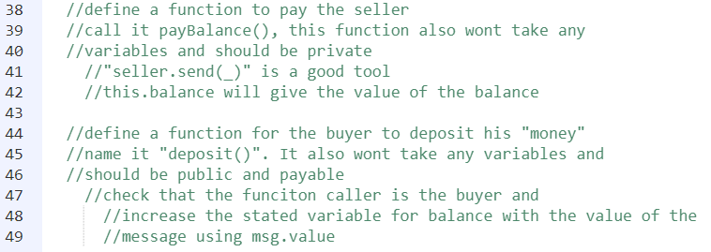
Writing an Escrow Contract!
Step four:

Slide 38
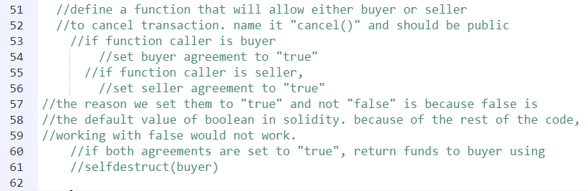
Writing an Escrow Contract!
Step five:

Slide 39
Let’s go over it!

Slide 40
Final Questions?

Slide 41
Other basics to explore
Fallback functions
Abstract contracts and interfaces
Other block and transaction properties
Events and javascript implementations
Truffle and Web3.js implementations

Slide 42
Conclusion & More
What we taught you today
There’s still a lot left to learn, but don’t be intimidated!
Here are resources you can use:
Ethereum White Paper:
https://github.com/ethereum/wiki/wiki/White-Paper
Solidity Development Documentation:
https://solidity.readthedocs.io/en/develop/

Slide 43
Thank you for coming!
Look forward to future
Blockchain at McGill events!

